Slide 1
Keeping Labor Safe – Phase 2
Machine Learning Outcomes
Lucas Finco

Slide 2
Analysis Process (to date)
Extract data samples of traces to re-produce strip
Identify UA baseline
Identify contractions
Calculate U, R, and U/R ratio
Calculate FHR baseline
Calculate FHR variability
Identify late recoveries
Identify accelerations

Slide 3
Fetal Risk Index Components
Excessive UA
FHR Baseline Range
FHR Variability
FHR Accelerations
FHR Late Recovery
Fetal Risk Factor
Maternal Risk Factor
Obstetric Risk Factor

Slide 4
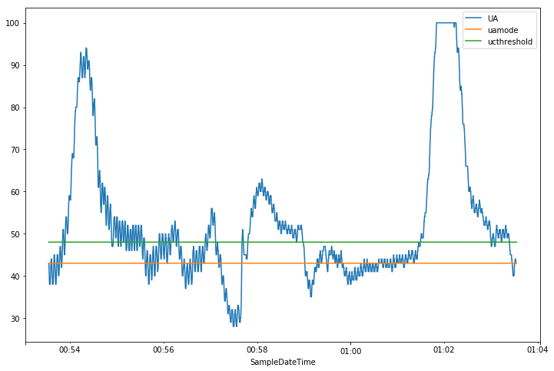
UA Thresholding
Samples of UA traces extracted for testing
Baseline (Orange)
Threshold (Green)
If mode is too high (above median), we use 25% quantile instead

Slide 5
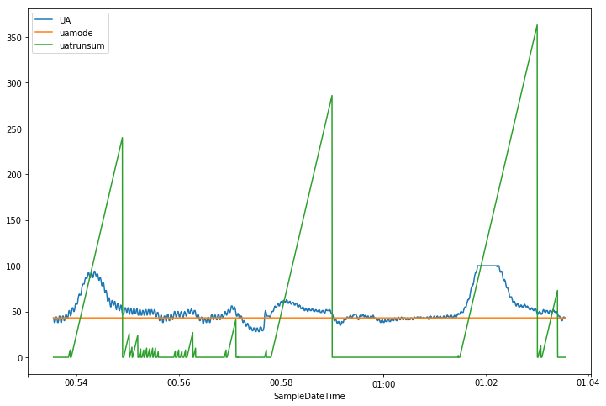
UA Contraction Identification
Count up time above Threshold
Clearly indicates Contractions
Mark all < 30sec

Slide 6
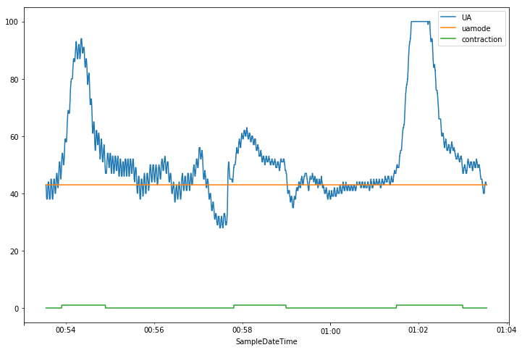
UA Contraction Identification
Contractions (Green)
Note contractions currently start 30sec in (we correct for this in the U/R ratio calculations)
In this example, 3 contractions are identified

Slide 7
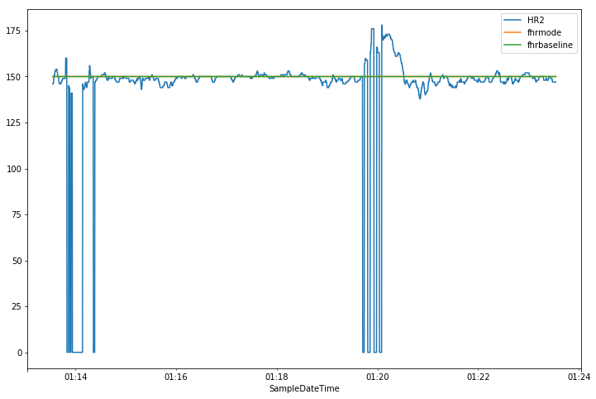
FHR Baseline
Use time not in contraction
Also remove all FHR=0 data
Identify FHR baseline via mode method
Again, if mode is above median, use the 25% quantile instead
Variability is standard deviation over same timespan

Slide 8
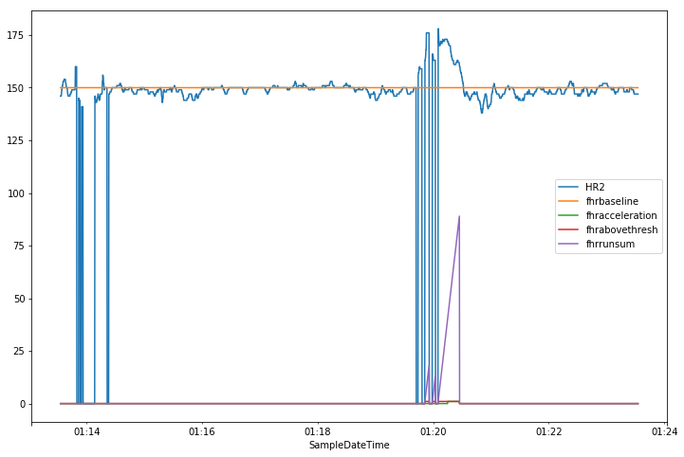
FHR Accelerations
Identify FHR levels more than 10 BPM above FHR baseline for more than 10 seconds
In this example, 1 acceleration is identified (purple line)

Slide 9
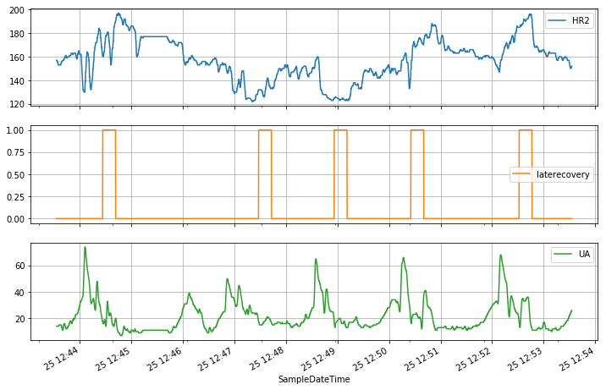
FHR Late Recoveries
Start at the end of each contraction
Identify FHR levels deviating from baseline more than 15 BPM above after 15 seconds
In this example, 5 late recoveries are identified

Slide 10
Results
Ground Truth provided by Dr. Eden’s review of strips provided
Number of observations: 22

Slide 11
Results: Excessive UA
Number of contractions exceeds 4 in 10 minutes
Accuracy: 86%
Sensitivity, Recall: 78%
Specificity: 92%
Precision, PPV: 88%
NPV: 86%
True Negative Rate: 92%
Good result, confident in conservative prediction, but could improve make less
 | Actual
Predicted |  | 0 | 1
 | 0 | 12 | 2
 | 1 | 1 | 7

Slide 12
Results: FHR Baseline
FHR Baseline < 110 or >= 160
Accuracy: 100%
Sensitivity, Recall: 100%
Specificity: 100%
Precision, PPV: 100%
NPV: 100%
True Negative Rate: 100%
Very strong result, note only one zero, no improvement needed
 | Actual
Predicted |  | 0 | 1
 | 0 | 1 | 0
 | 1 | 0 | 21

Slide 13
Results: FHR Accelerations
FHR Accelerations = 0
Accuracy: 91%
Sensitivity, Recall: 100%
Specificity: 67%
Precision, PPV: 89%
NPV: 100%
True Negative Rate: 67%
Good result, zero false negatives, but 2 false positives
 | Actual
Predicted |  | 0 | 1
 | 0 | 4 | 0
 | 1 | 2 | 16

Slide 14
Results: FHR Variability
FHR Variability < 5 or > 15
Accuracy: 77%
Sensitivity, Recall: 92%
Specificity: 60%
Precision, PPV: 73%
NPV: 86%
True Negative Rate: 60%
Good result, better at predicting zeros, which is important, but missed 5 zeros
 | Actual
Predicted |  | 0 | 1
 | 0 | 6 | 1
 | 1 | 4 | 11

Slide 15
Results: FHR Late Recovery
FHR Late Recovery Present
Accuracy: 77%
Sensitivity, Recall: 88%
Specificity: 50%
Precision, PPV: 82%
NPV: 60%
True Negative Rate: 50%
Good result, confident in prediction, but weak with actual zeros, and 2 false negatives
 | Actual
Predicted |  | 0 | 1
 | 0 | 3 | 2
 | 1 | 3 | 14

Slide 16
ToDo’s:
Use AUC method for late recoveries
Overshoots
Decelerations
Data Quality Metric
Analysis Confidence Metric

Slide 17
Recommendations
Collect ground truth at the source of the data
When contractions happen
When accelerations happen
When late recoveries happen

Slide 18
Appendix

Slide 19
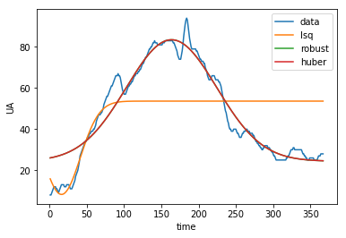
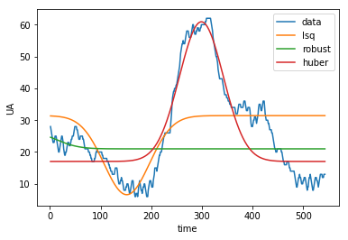
UA Curve Fitting
Samples of UA traces extracted and fit for testing
Fitting normal curve y = a +b * e^{c*t2}

Slide 20
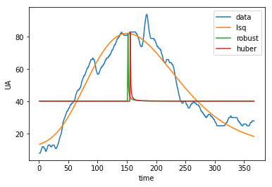
UA Curve Fitting
Samples of UA traces extracted and fit for testing
Fitting log-normal curve y = a +b * log(e^{c*t2})
Many different shapes
Not confident in optimizer

Slide 21
UA Curve Fitting - Conclusion
Challenging to find a consistent curve fitting method that will work
If it could work consistently, we could extract extra insights from UA shapes:
Bell curve or log-normal
Width/height factor

Slide 22
Text
Text
Text
Text

Slide 23
Text
Text
Text

